Slide 1


Titolo presentazione sottotitolo
Improving DaaS with Kubernetes in Fog
Computing Environments
Milano, XX mese 20XX
Relatore: Prof. Monica Vitali
Correlatore: Prof. Pierluigi Plebani
Presented by: Sun Chao

Slide 2
CONTENT
BACKGROUND
REACHER GOALS
STATE OF ART
DaaS FRAMEWORK IN FOG COMPUTING
IMPLEMENTATION
KUBERNETES ARCHITECTURE OVERVIEW
CUSTOMIZED MONITORING SYSTEM
CONTAINERIZED APPLICATION
DEMO TIME
FUTURE WORK

Slide 3
BACKGROUND
Data-intensive applications are usually developed based on Cloud resources which can provide reliable and scalable services
Countless data have also been generated by Internet of Things-based devices
Device heterogeneity: IoT devices generate data with diﬀerent format and quality
Two major challenges raised when designing data-intensive applications by handling these data:
privacy and security
latency

Slide 4
RESEARCH GOALS
Design an architecture which is able to handle data and computation movement between distributed computation resources
Deploy an DaaS platform which is able to provide expected data to different data-intensive application developers with the specific functionality and non-functionality requirements
Develop and deploy a customized monitoring system for our platform
Develop a containerized application which is used in our platform to simulate the data processing activity in order to fit the data requirements

Slide 5
STATE OF ART
Data intensive application
Fog computing
Virtualization techniques
Hypervisor-based Virtualization
Container-based Virtualization
Docker containers
Kubernetes
Prometheus

Slide 6
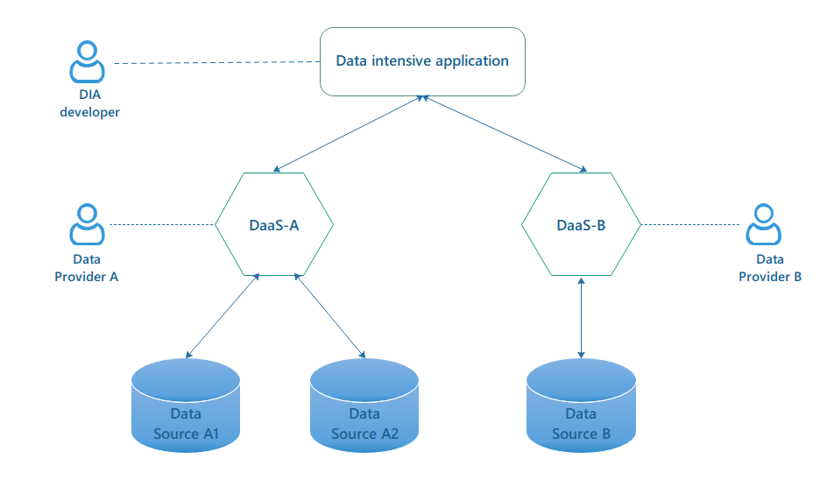
DaaS FRAMEWORK IN FOG COMPUTING
Figure 1: Data-as-a-Service architecture

Slide 7
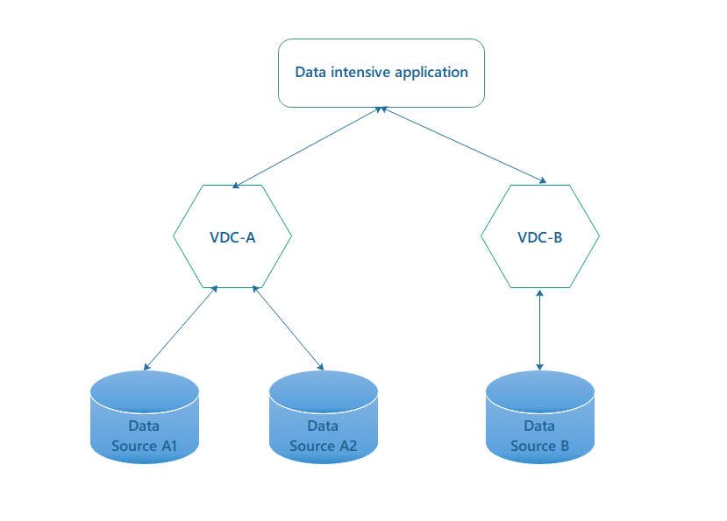
Personalization of the DaaS
Figure 2: The role of VDC in DaaS architecture

Slide 8
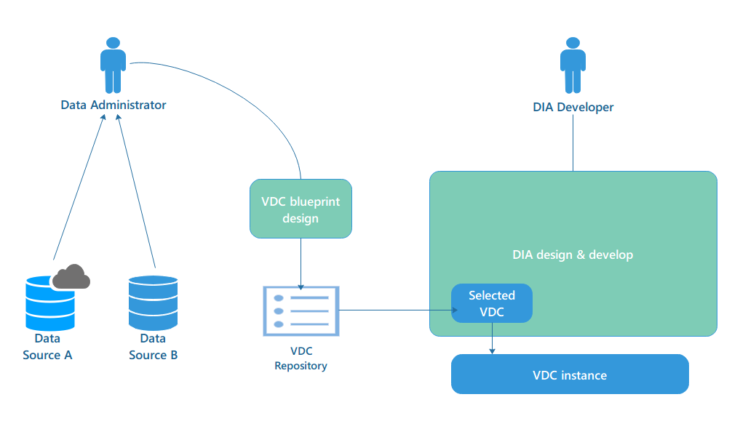
THE ADOPTION OF VDC
The VDC (Virtual Data Container) is a concrete element that is used to interoperate with both the distributed data sources and the Data Intensive Application with its own requirements.
Figure 3: Generation flow of the VDC instance

Slide 9
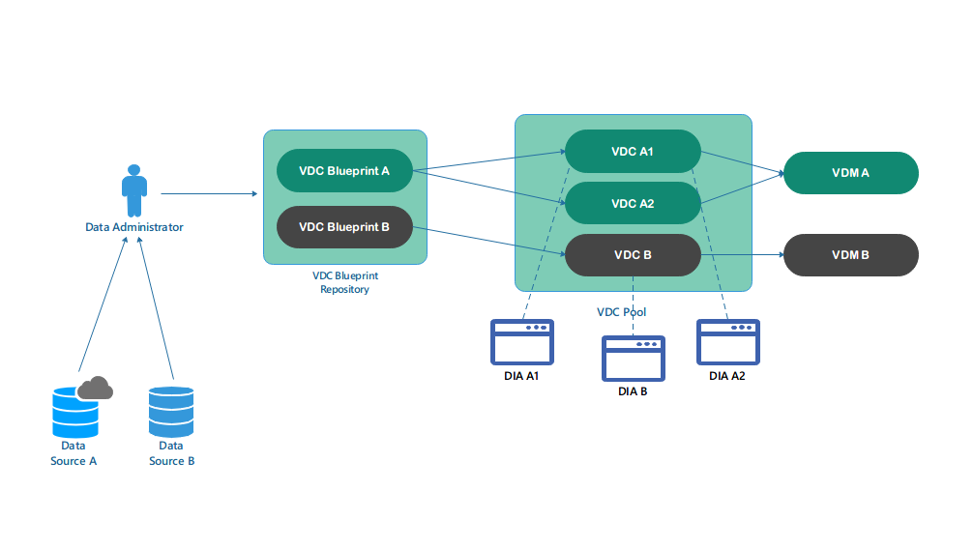
THE ADOPTION OF VDM
Virtual Data Manager (VDM) is a module used to control the behavior of the diﬀerent instances of the same VDC blueprint and ensure there is no conﬂict when enacting data and computation movements
Figure 4: The role of VDM in DaaS architecture

Slide 10
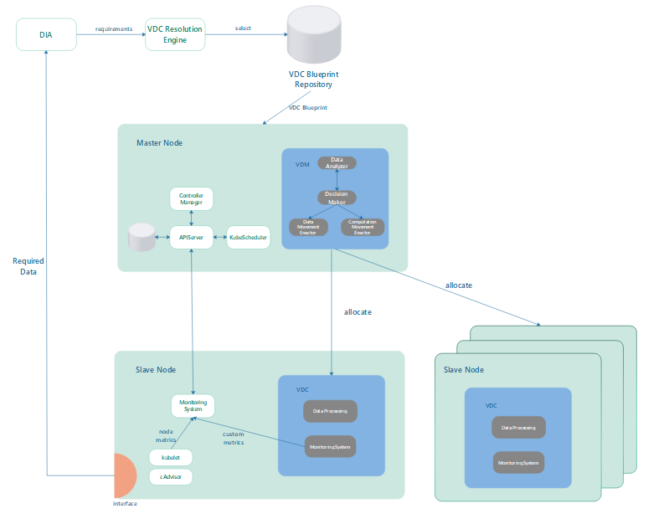
IMPLEMENTATION
Figure 5: Kubernetes architecture overview

Slide 11
CUSTOMIZED MONITORING SYSTEM
Metrics involved in the monitoring system:
Resource metrics:
CPU utilization
Memory utilization
Network throughput
Custom metrics:
Data processing response time
HTTP request number
HTTP request failure number

Slide 12
CUSTOMIZED MONITORING SYSTEM
Feasible monitoring system in Kubernetes
cAdvisor: it is a resource usage and performance analysis agent built for the container.
Heapster: it is a cluster-wide aggregator to collect and interpret various signals like compute resource usage, lifecycle events, etc.
Prometheus: it is an open source Cloud Native Computing Foundation (CNCF) project to monitor applications and microservices running in containers at scale
we decide to select Prometheus as the main monitoring system for two reasons:
Prometheus is able to monitor all the components within a Kubernetes cluster
The custom metrics are usually emitted in Prometheus format, while Heapster does not implement Prometheus as a data sink

Slide 13
THE DEPLOYMENT OF PROMETHEUS
Prometheus Operator: it introduces additional resources in Kubernetes to
declare the desired state of a Prometheus cluster as well as the Prometheus conﬁguration. The ThirdPartResources (TPR) includes: Prometheus, ServiceMonitor, Alertmanager.
Service Monitor: it speciﬁes how metrics can be retrieved from a set of services exposing them in a common way. The Operator conﬁgures the Prometheus instance to monitor all services covered by included ServiceMonitors and keeps this conﬁguration synchronized with any changes happening in the cluster.
Node Exporter: it is used to monitor the resources on each node, including
CPU, memory, and disk utilization. By default, kubernetes tracks monitoring
metrics through the cAdvisor service on all the nodes.
kube-state-metrics: it is a service that listens to the Kubernetes API server and generates metrics about the state of the objects.

Slide 14
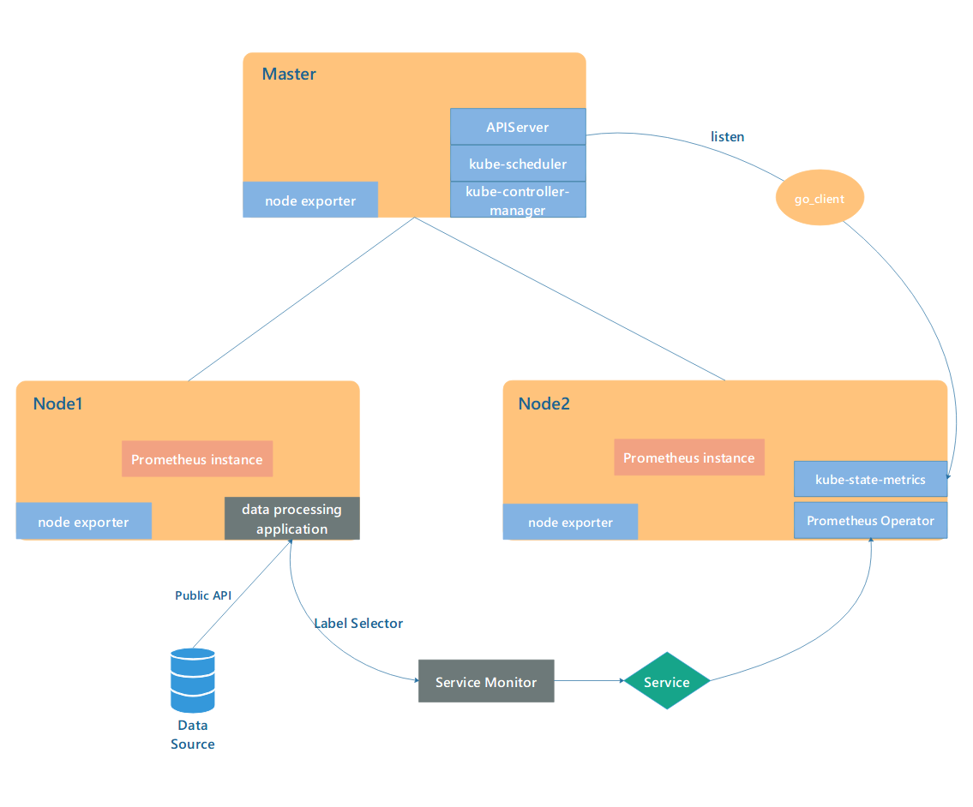
THE DEPLOYMENT OF PROMETHEUS
Figure 6: The Prometheus components inside a Kubernetes cluster

Slide 15
THE PROMETHEUS INSTANCE FOR APPLICATION METRICS
To separate the access priviledge to different components, we set two Prometheus instances. One is used for monitoring the regular cluster metrics for all Kubernetes objects, and the other one is used to pull custom metrics exposed by some specific applications (VDCs).
Assume we have already deployed an application which is able to expose some custom metrics in Prometheus format through HTTP endpoints. The overview deployment pipeline is presented in Figure 7.

Slide 16
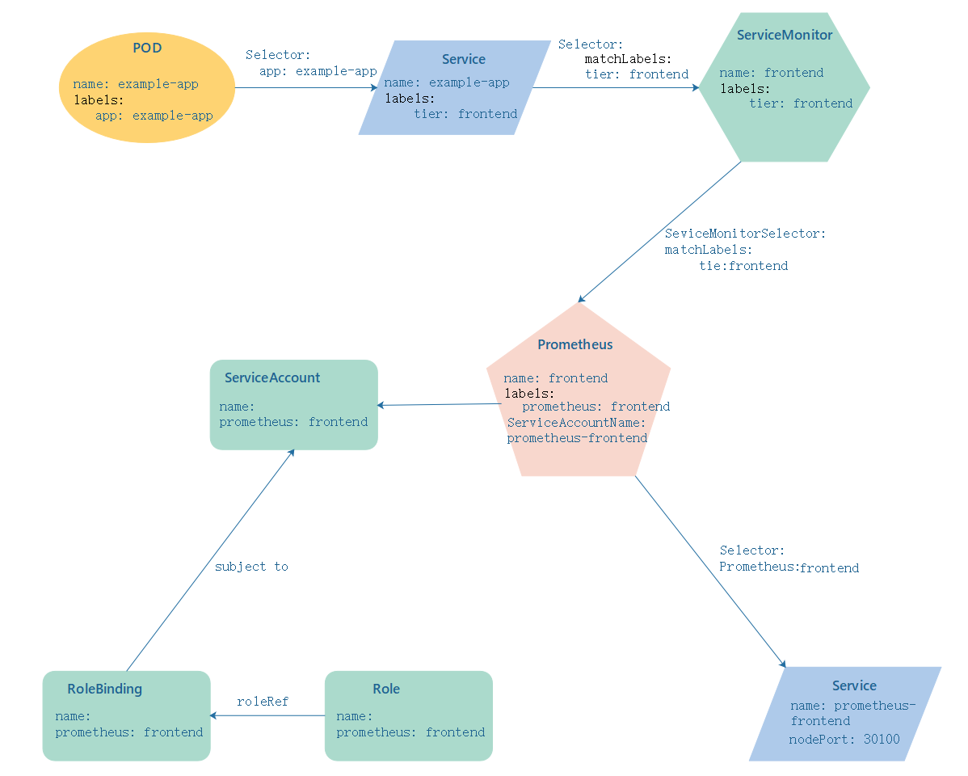
THE PROMETHEUS INSTANCE FOR APPLICATION METRICS
Figure 7: The deployment pipeline for monitoring custom metrics

Slide 17
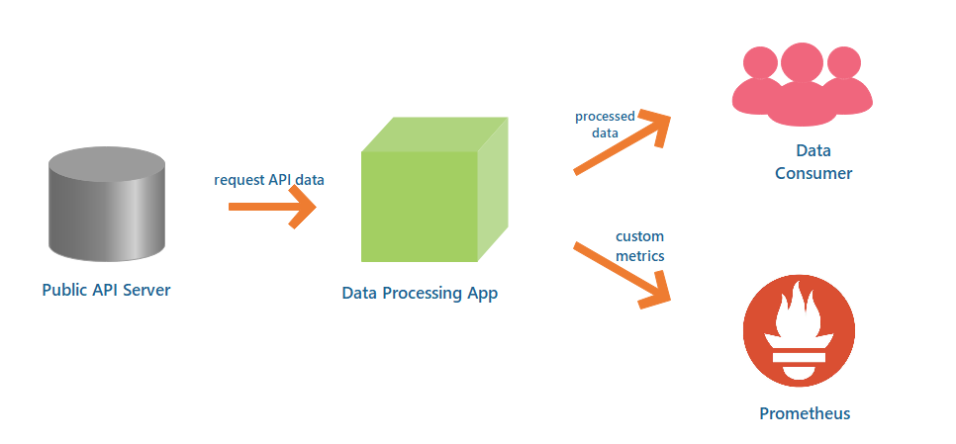
CONTAINERIZED APPLICATION DEVELOPMENT
Figure 7: Data pipeline of the data processing application

Slide 18
CONTAINERIZED APPLICATION DEVELOPMENT
The Public API Server collects public API services from all over the world through Internet. The base URL for this server is https://api.publicapis.org/.
The instrument application is developed with a Prometheus client library, so that it is able to expose custom metrics in Prometheus format.
By sending GET /category request to the Public API Server, our application is able to receive a JSON file including all the information related with that category.
With the received data, we apply SHA-512 hash transform function to encrypt this data string and then expose the processed data with a REST API.
At the same time, the application exposes the predefined custom metrics to the Prometheus instance through a HTTP endpoint (/metrics).
Finally, the developed application should be packaged into a docker file and stored into Dockerhub repository.

Slide 19
DEMO TIME

Slide 20
FUTURE WORK
Three custom metrics are too limited to track the running states for a huge number of VDCs, more metrics should be designed and attached to our customized monitoring system.
Since the customized monitoring system is ready, we still need to enact a data and computation movement based on the monitoring data. The data and computation movement actions should be triggered by the VDM, which is used to control the activities for its connected VDCs.
The developed platform right now is supported by Cloud Service Provider which provides several Virtual Machines relying on the cloud data-center. To provide a truly Fog Computing environment, some ARM devices(e.g., Raspberry PI) should be connected to our Kubernetes cluster as the edge side.

Slide 21

THANK YOU!
QUESTION TIME

